Slide 1
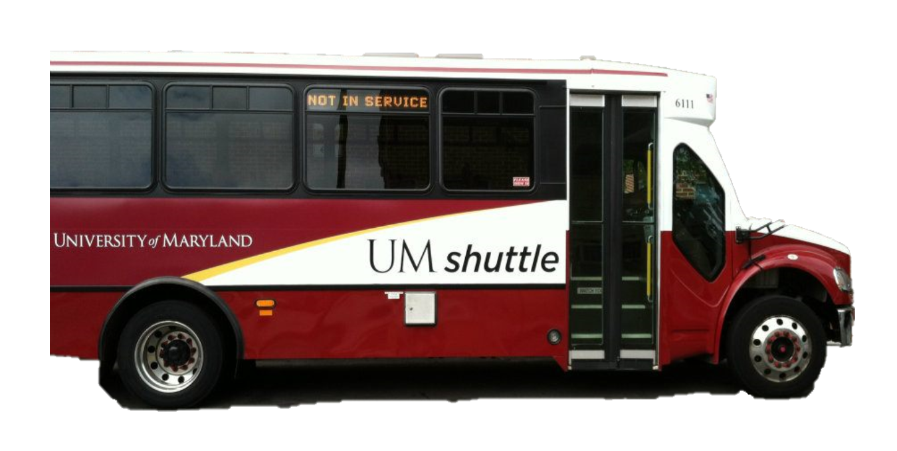
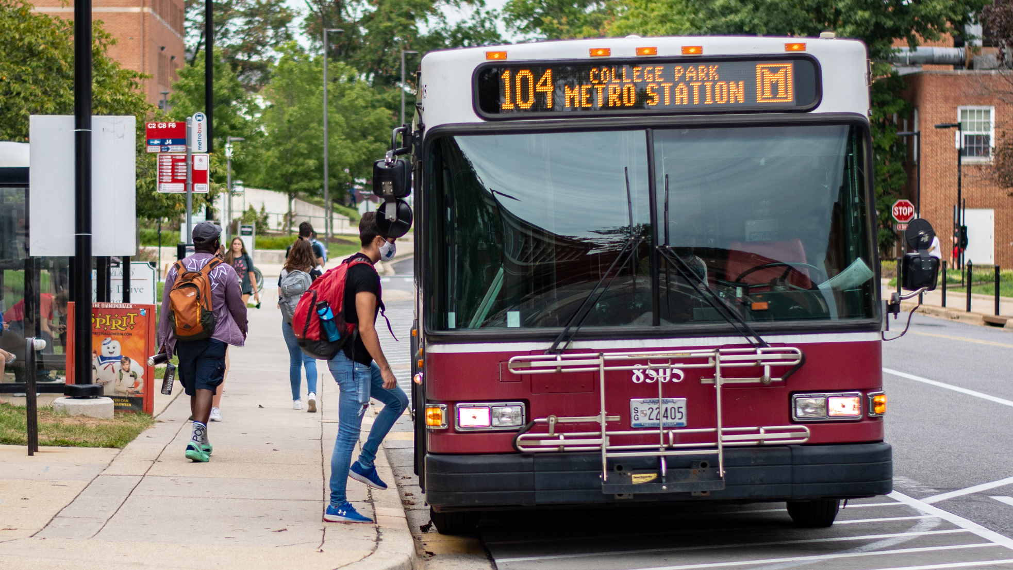
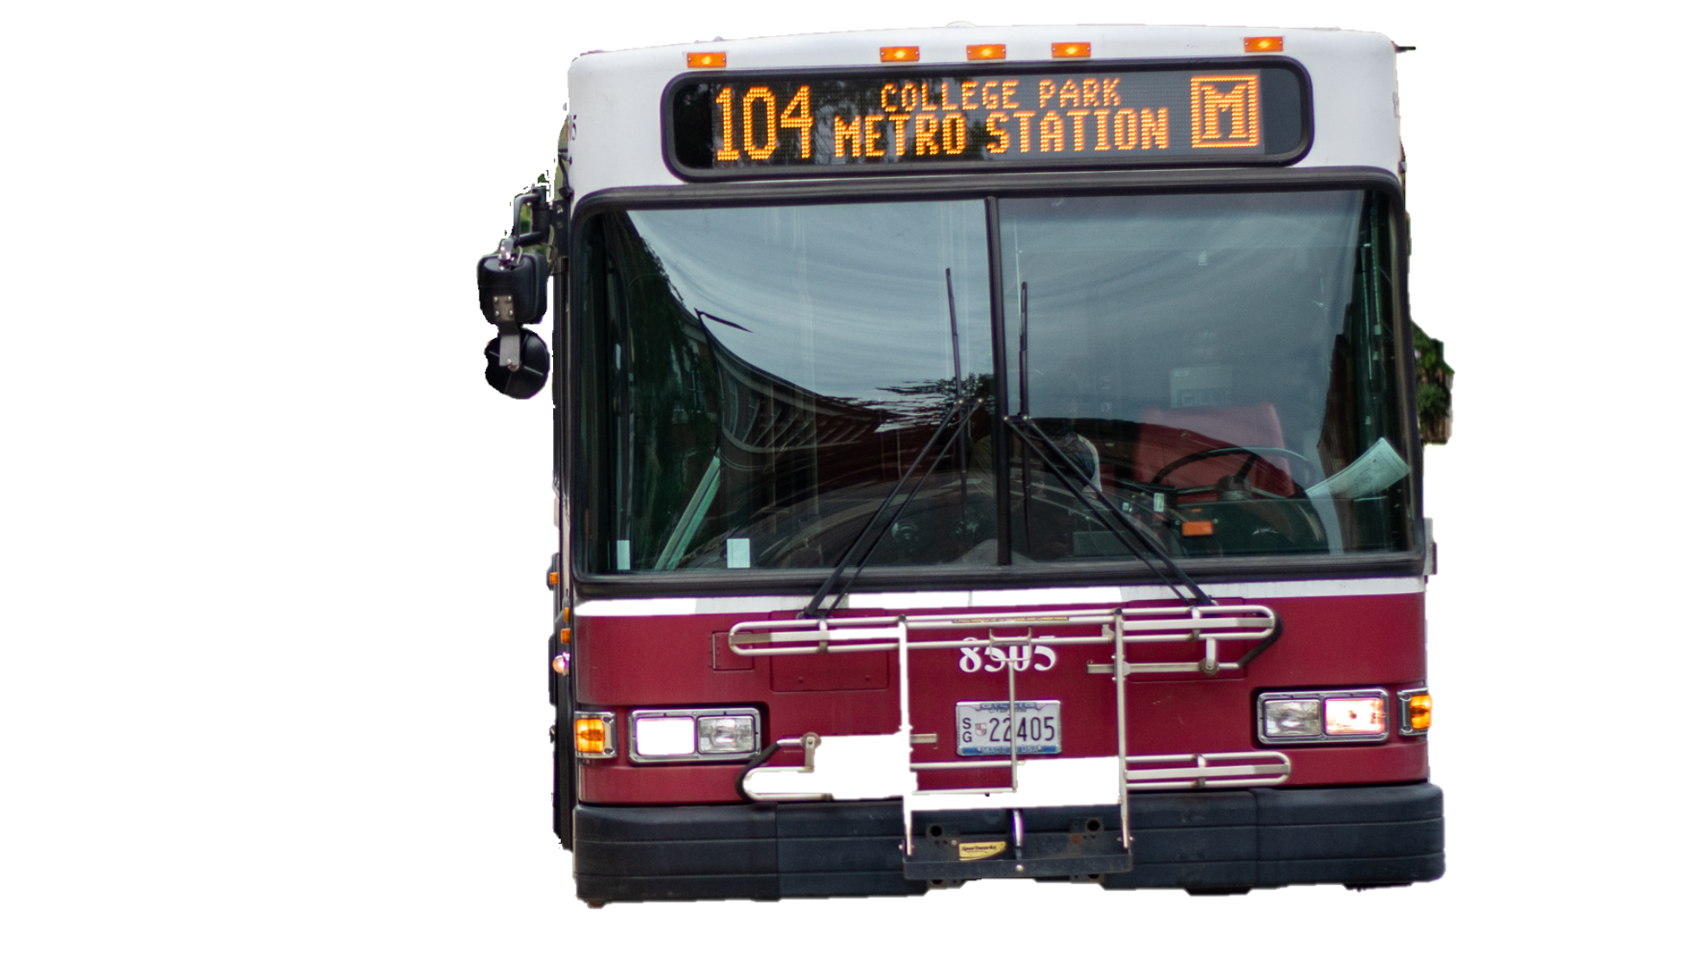
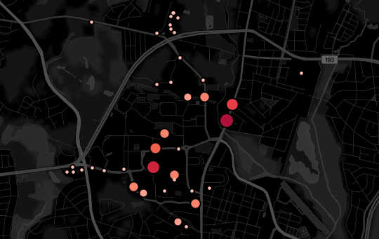
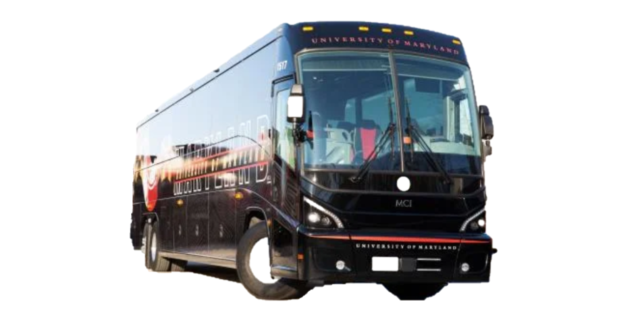
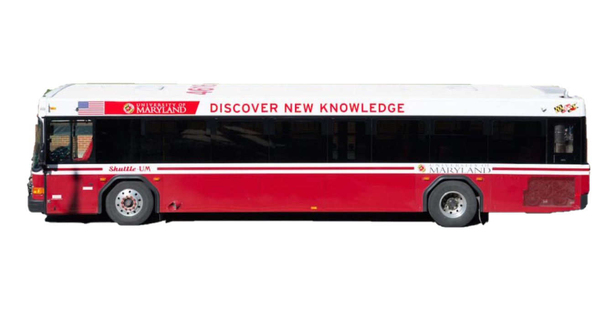

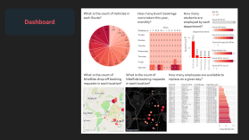
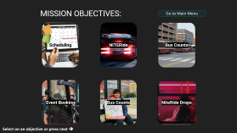
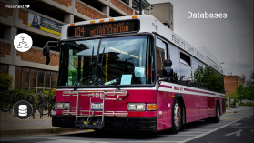
Jump To Slide (click on):
DOTS UMD
Introduction
Database
Consulting Firm
Mission Objectives
Dashboard

Slide 2

DOTS UMD
DOTS is committed to providing safe, cost effective and innovative services that anticipate the needs of our growing community of more than 50,000 students,faculty and staff in the city of College Park and beyond.
Consulting Firm

Slide 3

DOTS UMD
The main objective of this project is to have a simple but efficient database structure for the Department of Transportation in order to maintain the data and to look into real time day-to-day schedules and activities of the various departments that are a part of DOTS. This database along with the university student database can be helpful in increasing the service times and expanding the routes for the benefit of students accordingly. The final aim is to provide seamless transportation service to all the students of the University.

Slide 4

DOTS UMD
As DOTS consultant we aim to provide DOTS UMD with the following services:
To show the number of NITERide pickups in each location points
To gain insights about the events that occur and to use them for predicting peak event booking times.
To identify available employees for a given day schedule.
To know which department actively recruits most number of students from the University.

Slide 5
DOTS UMD
MAIN TRANSPORTATION SERVICES IN CONSIDERATION FOR THIS PROJECT:
NITERide
Schedule: 5:30pm – 7:30am
Transloc App to book a ride.

Slide 6
DOTS UMD
MAIN TRANSPORTATION SERVICES IN CONSIDERATION FOR THIS PROJECT:
Special Events
Schedule: Booked on DOTS
For university related events.

Slide 7
DOTS UMD
MAIN TRANSPORTATION SERVICES IN CONSIDERATION FOR THIS PROJECT:
UM Shuttle
Schedule: Pre-Determined Schedule
For UMD Students

Slide 8
SOURCE OF DATA:
UMD Website
Transit
Transloc
Crowd Sourcing (Google forms)

Slide 9
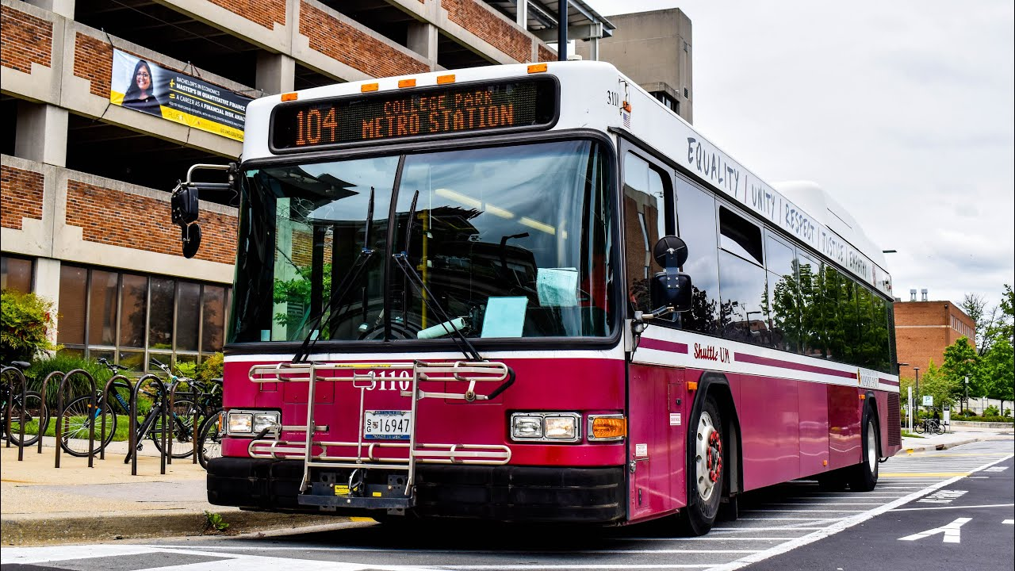


Press next ➔
Databases

Slide 10
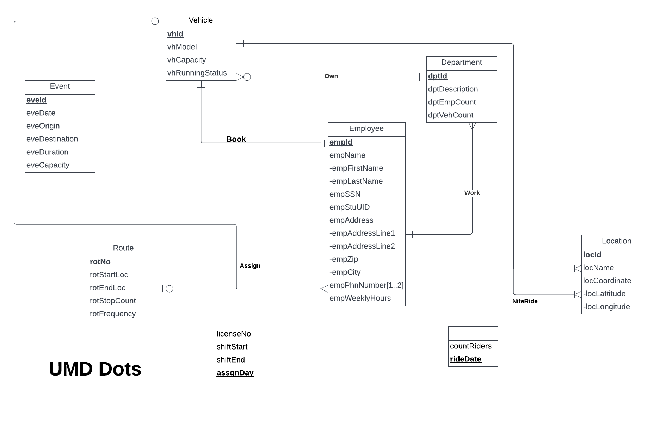

Conceptual & Relational Database
Assign ( empId, vhId, rotNo, licenseNo, shiftStart, shiftEnd, assgnDay) – Ternary Relation
Book ( empId, vhId, eveId ) - Ternary Relation
Niteride(vhId, empId, picLocId, dropLocId, rideDate, countRiders) - Quaternary Relation

Slide 11
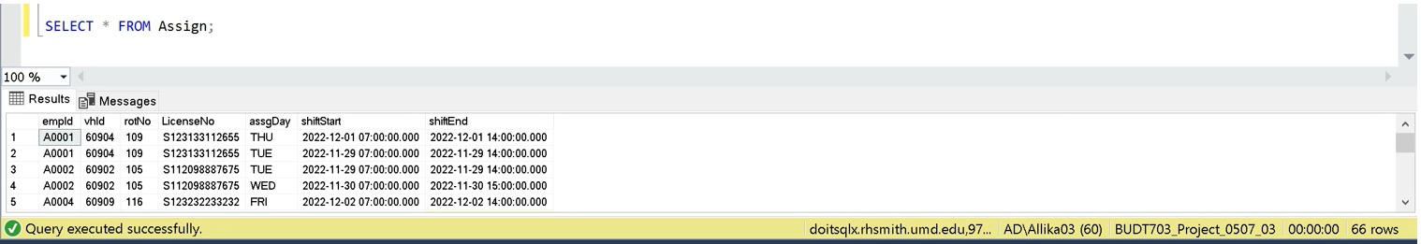
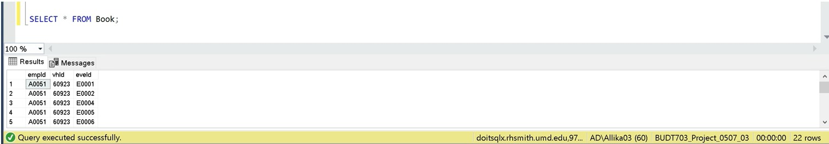
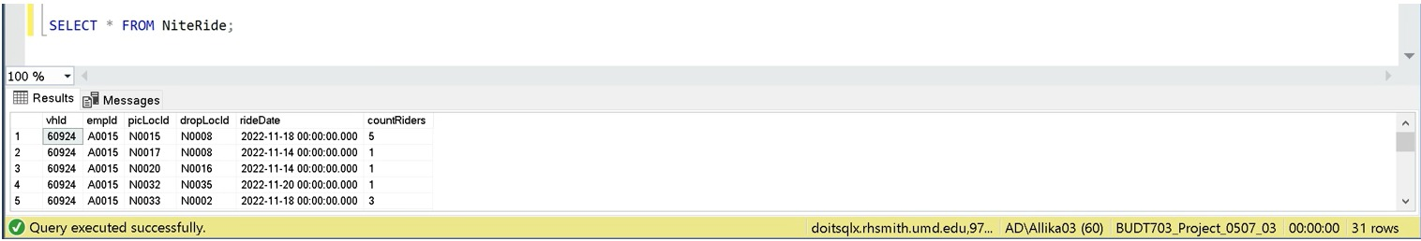
UM-SHUTTLE ASSIGN (SCHEDULE)
EVENT BOOKING
NITE RIDE BOOKINGS)

Slide 12
Databases

Slide 13
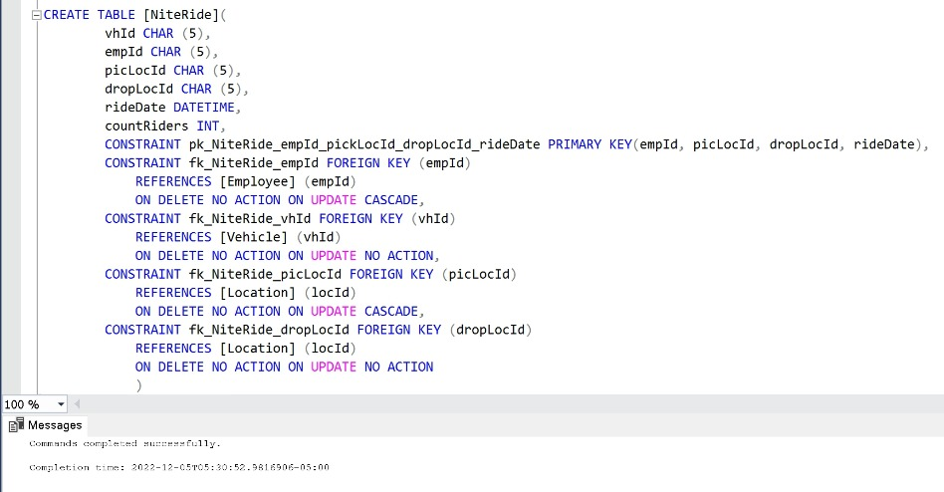
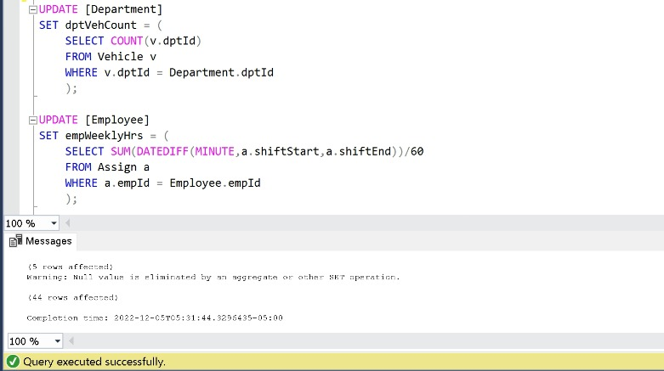
Physical Database

Slide 14
Databases

Slide 15


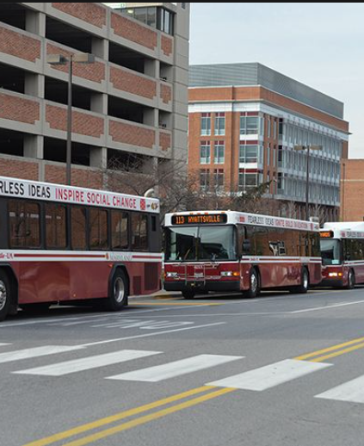

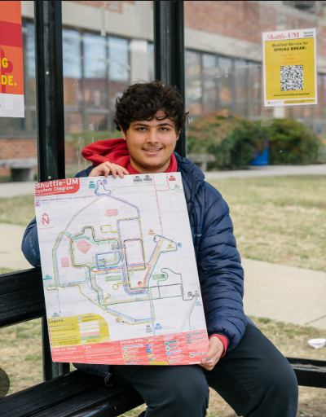

MISSION OBJECTIVES:
Go to Main Menu
Scheduling
NITERide
Bus Counts
Event Booking
Bus Counts
NiteRide Drops
Select on an objective or press next ➔

Slide 16
1: How many employees are available to replace on a given day?
Query
Result
Visualization
Go Back to Objectives

Slide 17
Query
How many employees are available to replace on a given day?
SELECT DISTINCT e.empId, e.empFirstName, a.vhId, d.dptDescription, e.empWeeklyHrs
FROM Employee e, Assign a, Department d
WHERE (SELECT UPPER(DATENAME(WEEKDAY,GETDATE()))) NOT LIKE (CONCAT(a.assgDay, '%')) AND
(a.shiftEnd IS NOT NULL) AND
(e.empWeeklyHrs < 20) AND
(a.empId=e.empId) AND
(e.dptId=d.dptId)
ORDER BY e.empWeeklyHrs;
The other days of the week that is not today

Slide 18
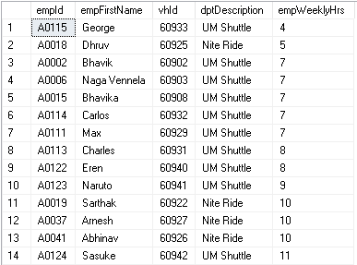
How many employees are available to replace on a given day?
Result
Go Back to Objectives

Slide 19
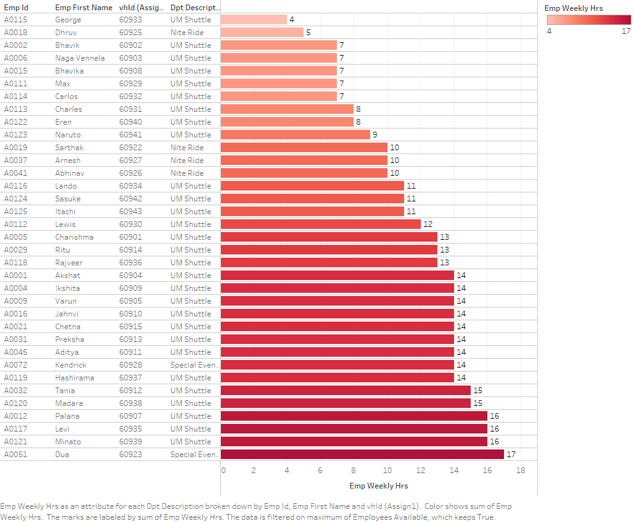
How many employees are available to replace on a given day?
Visualization
Go Back to Objectives

Slide 20


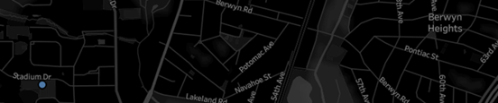
What is the count of NiteRide booking requests in each location?
Query
Result
Visualization
Go Back to Objectives

Slide 21
Query
What is the count of NiteRide booking requests in each location?
SELECT l.locName , COUNT(n.picLocId) AS 'PickUp Count’
FROM [Location] l
LEFT JOIN NiteRide n ON l.locId = n.picLocId
GROUP BY n.picLocId, l.locNameORDER BY COUNT(n.picLocId) DESC;
Go Back to Objectives

Slide 22
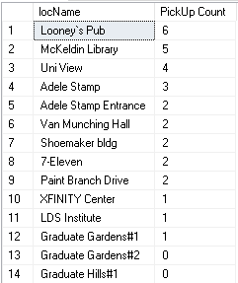
Result
What is the count of NiteRide booking requests in each location?
Go Back to Objectives

Slide 23
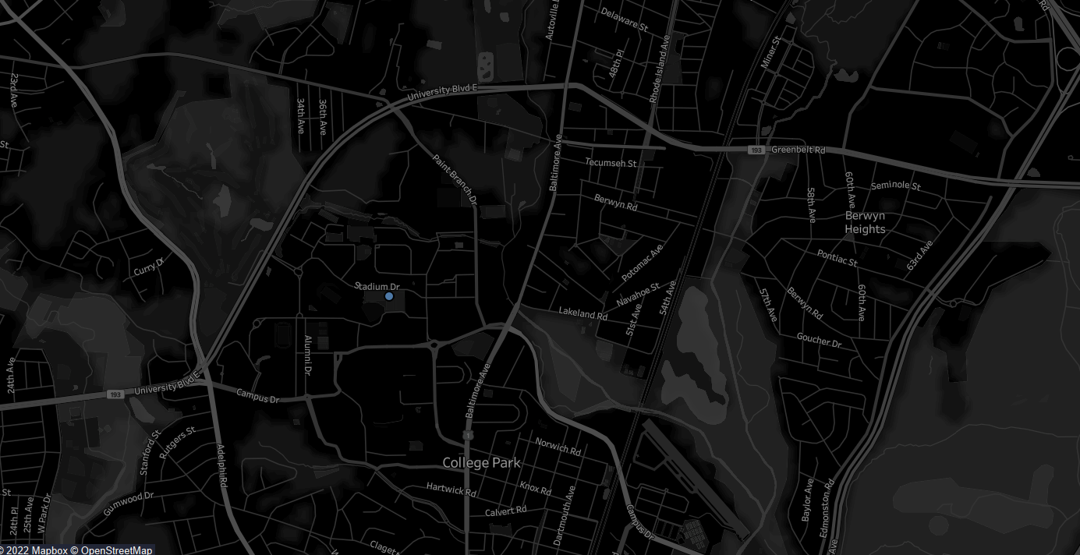
Visualization
What is the count of NiteRide booking requests in each location?
Go Back to Objectives

Slide 24
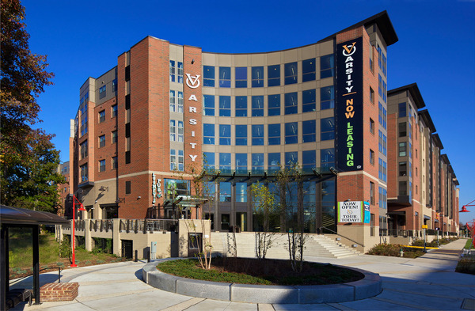

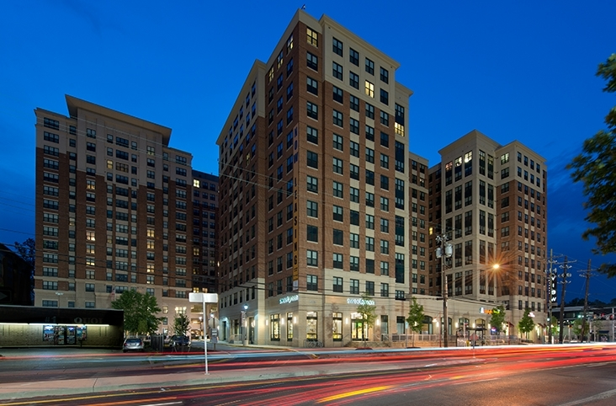
What is the count of NiteRide booking requests in each location?
Go Back to Objectives

Slide 25
Top 3 pickup Locations
What is the count of NiteRide booking requests in each location?
Varsity/Looney`s Pub:
Count of Picups : 6
Proximity to recreational pubs and university housings

Slide 26
Top 3 pickup Locations
What is the count of NiteRide booking requests in each location?
McKeldin Library:
Count of Picups : 5
Students involved in late night study sessions

Slide 27
Top 3 pickup Locations
What is the count of NiteRide booking requests in each location?
University View:
Count of Picups : 4
Proximity to recreational clubs and student housing

Slide 28
3:What is the count of Vehicles in each Route?
Query
NiteRide Drops
Result
Visualization
Go Back to Objectives

Slide 29
Query
What is the count of Vehicles in each Route?
SELECT a.rotNo, COUNT(a.vhId) AS 'Vehicle Count'
FROM Assign a
GROUP BY a.rotNo
Go Back to Objectives

Slide 30
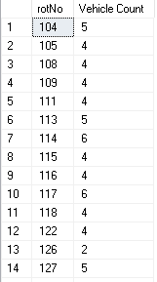
Result
Go Back to Objectives

Slide 31
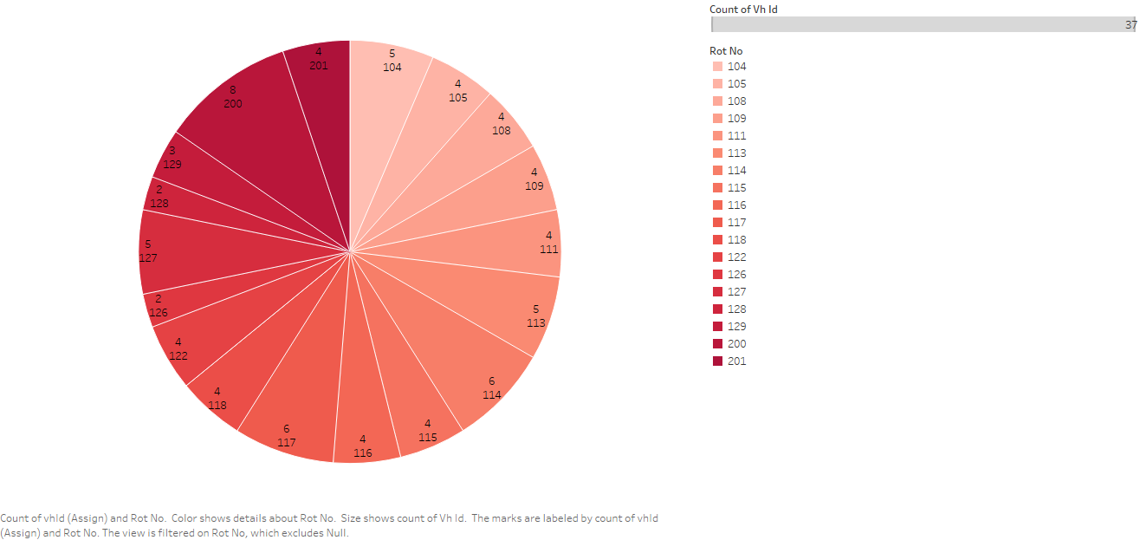
Visualization
Go Back to Objectives

Slide 32
4: How many Event bookings were taken this year, monthly?
Query
Bus Counts
Result
Visualization
Go Back to Objectives

Slide 33
Query
How many Event bookings were taken this year, monthly?
SELECT COUNT(e.eveId) AS 'Number of Events', MONTH(e.eveDate) AS 'Month'
FROM [Event] e
WHERE eveDate >= '01-01-2022'
AND eveDate <= '12-31-2022'
GROUP BY MONTH(e.eveDate);
Result
Go Back to Objectives

Slide 34
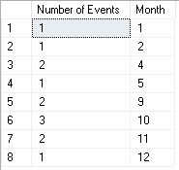
How many Event bookings were taken this year, monthly?
Result
Go Back to Objectives

Slide 35
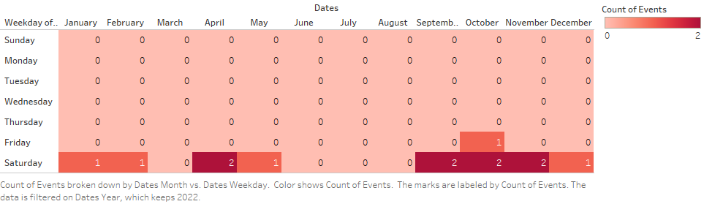
How many Event bookings were taken this year, monthly?
Visualization
Bus Counts
Event Booking
Go Back to Objectives

Slide 36
5: How many students are employed by each department?
Query
Result
Visualization
Go Back to Objectives

Slide 37
Query
How many students are employed by each department?
SELECT e.dptId AS 'Department ID', d.dptDescription AS 'Department Name', COUNT(e.empId) AS 'Student Count'
FROM Employee e, Department d
WHERE e.dptId=d.dptId AND e.empStuUID IS NOT NULL
GROUP BY e.dptId, d.dptDescription;
Go Back to Objectives

Slide 38
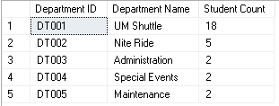
How many students are employed by each department?
Result
Go Back to Objectives

Slide 39
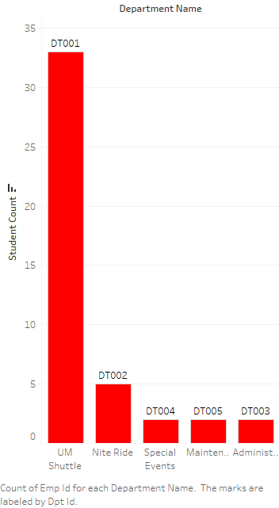
How many students are employed by each department?
Visualization
Go Back to Objectives
Bus Counts
NiteRide Drops

Slide 40
6: What is the count of NiteRide drop off booking requests in each location?
Query
Bus Counts
Result
Visualization
Go Back to Objectives

Slide 41
Query
What is the count of NiteRide drop off booking requests in each location?
SELECT l.locName , COUNT(n.dropLocId) AS 'Drop Location Count'
FROM [Location] l LEFT JOIN NiteRide n
ON l.locId = n.dropLocId
GROUP BY n.dropLocId, l.locName
ORDER BY COUNT(n.dropLocId) DESC

Slide 42
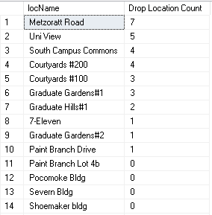
What is the count of NiteRide drop off booking requests in each location?
Result
Result
Go Back to Objectives

Slide 43
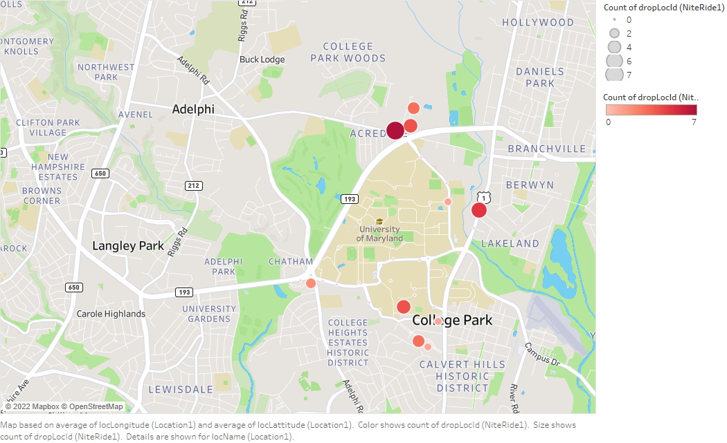
What is the count of NiteRide drop off booking requests in each location?
Visualization
Go Back to Objectives
Bus Counts
NiteRide Drops
Dashboard

Slide 44
Back to Objectives
View Dashboard

Slide 45
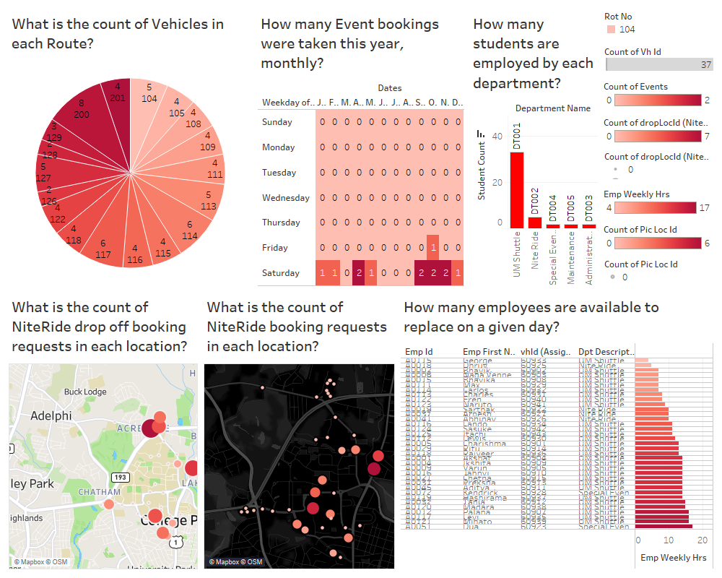
Bus Counts
NiteRide Drops
Dashboard

Slide 46
Thank You.
By Sreerag Mahadevan Cheeroth

